Slide 1
Voice Notification API Introduction By Jincui Niu

Slide 2
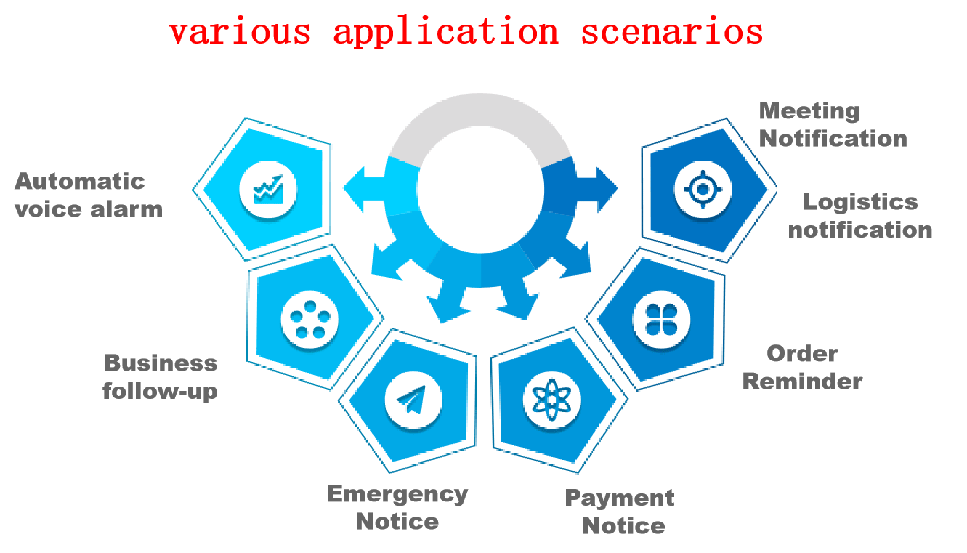
Voice Notification API
1.Capabilities
Application call method, based on IMS network resources, batch sends various voice notification broadcasts to end users through call method, with characteristics such as high arrival rate, ultra-low latency, second level reach, large capacity, and high concurrency.
2. Innovation Points of API capabilities
High notification timeliness: Addressing the issues of delayed text messages and low attention, voice notifications can provide strong reminders, making them more real-time and instantly accessible to users.
The notification content can be customized: users can personalize the notification content by selecting voice gender, speed, tone, notification time, and frequency. They can also choose to provide voice files or text content with variables, greatly improving the user experience.
Notification efficiency: It can send voice notifications to numerous users in batches simultaneously, greatly improving dissemination efficiency and reducing labor and time costs.
3. Typical Application Scenarios

Slide 3


Voice Notification API
4.Application effects
Using voice notifications can improve the efficiency and accuracy of information dissemination, increase the interactivity and personalization of information, and bring better user experience and results.
5. Introduction to Business Processes
The Open Gateway firstly assigns enterprise IDs and tokens to customers for calling voice notification API.
1. The enterprise side automatically initiates a call by setting the caller, and the enterprise application server calls the voice notification API (carrying the called number, notification content text, or audio and video file URL) to request a call.
2. Call the called 1-N numbers, and after the call is established and connected, directly play the pre recorded audio and video files.
3. Notification text content can also be sent, and Open Gateway can call the TT service module to convert the text into voice before calling the called party UE for notification broadcast.
web/Client/APP/portal
enterprise application servers
1. Call the voice notification API application
(Submit the called number, notification content text/audio and video file URL)
3. Call number 1-N
Broadcast voice notification after connection
Operator IMS network
UE 1
Open Gateway Voice notification
UE 2
2. Notification Content Text
UE N
TTS

Slide 4
Voice Notification API
6. API interface parameters
Interface Name | Voice notification
API Description | Call numerous users and play the specified voice content after connecting
Requested parameters | VCCID:Enterprise ID
 | calling number
 | Called Number/Number List
 | The voice content to be played (text or voice file)
 | Repeated playback count
 | Event push URL
 | Is it recorded
 | User defined business data
Response parameters | Call result

